Slide 1
Word2Vec
HE Huifan
NEC Laboratories Singapore

Slide 2
Syllabus
Word2Vec Overview
NNLM(Neural Network Language model)
CBOW/Skip-gram
Hierarchical Softmax and Negative Sampling

Slide 3
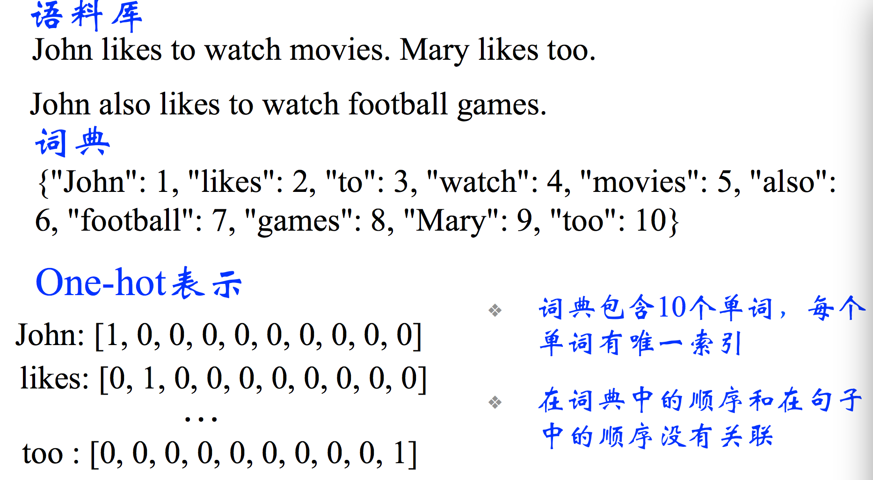
Document Representation: Bag of Words
Dictionary
One-Hot
There are 10 words in dictionary,
each word corresponds to 1 index
No correlation between the order
of words in dictionary and the
order in sentence

Slide 4
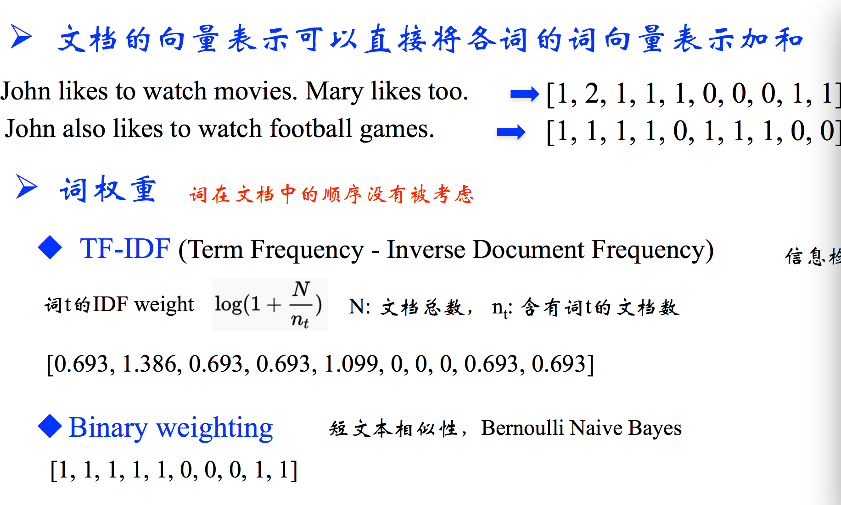
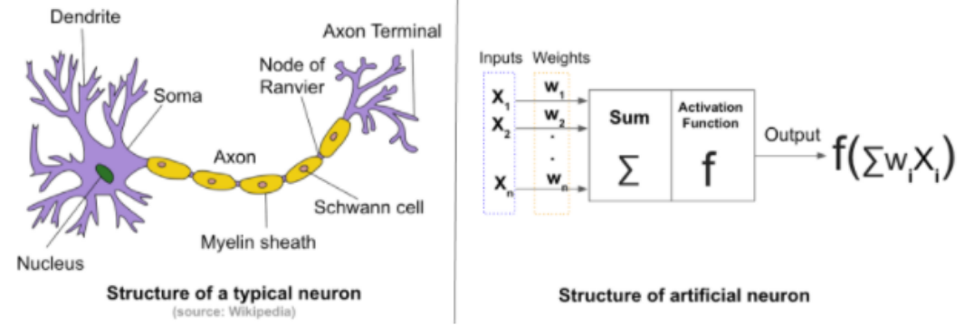
Document Representation: Bag of Words
The document can be represented as the sum of the vector of each word
The weight of word The order of word in document is not considered
Information Retrieval

Slide 5
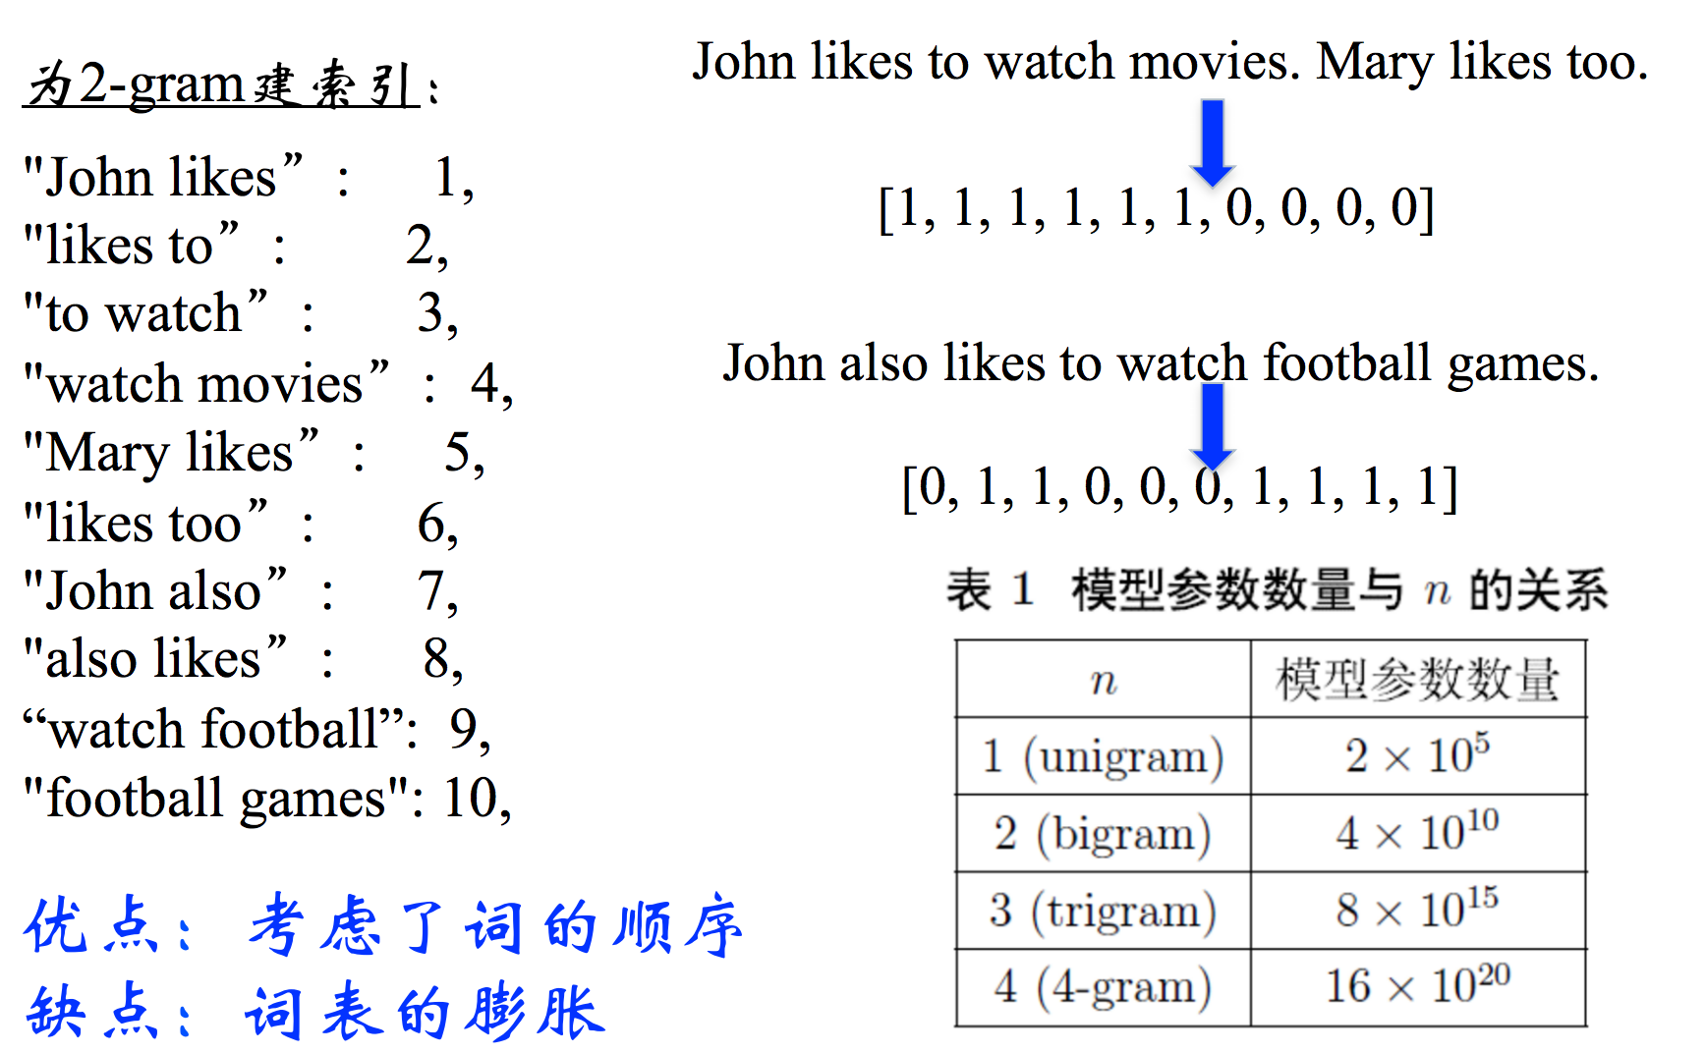
Document Representation: Bi-gram and N-gram
Index of Bi-gram
n
Feature number
Pro: Consider the order of words
Cons: Expansion of features

Slide 6
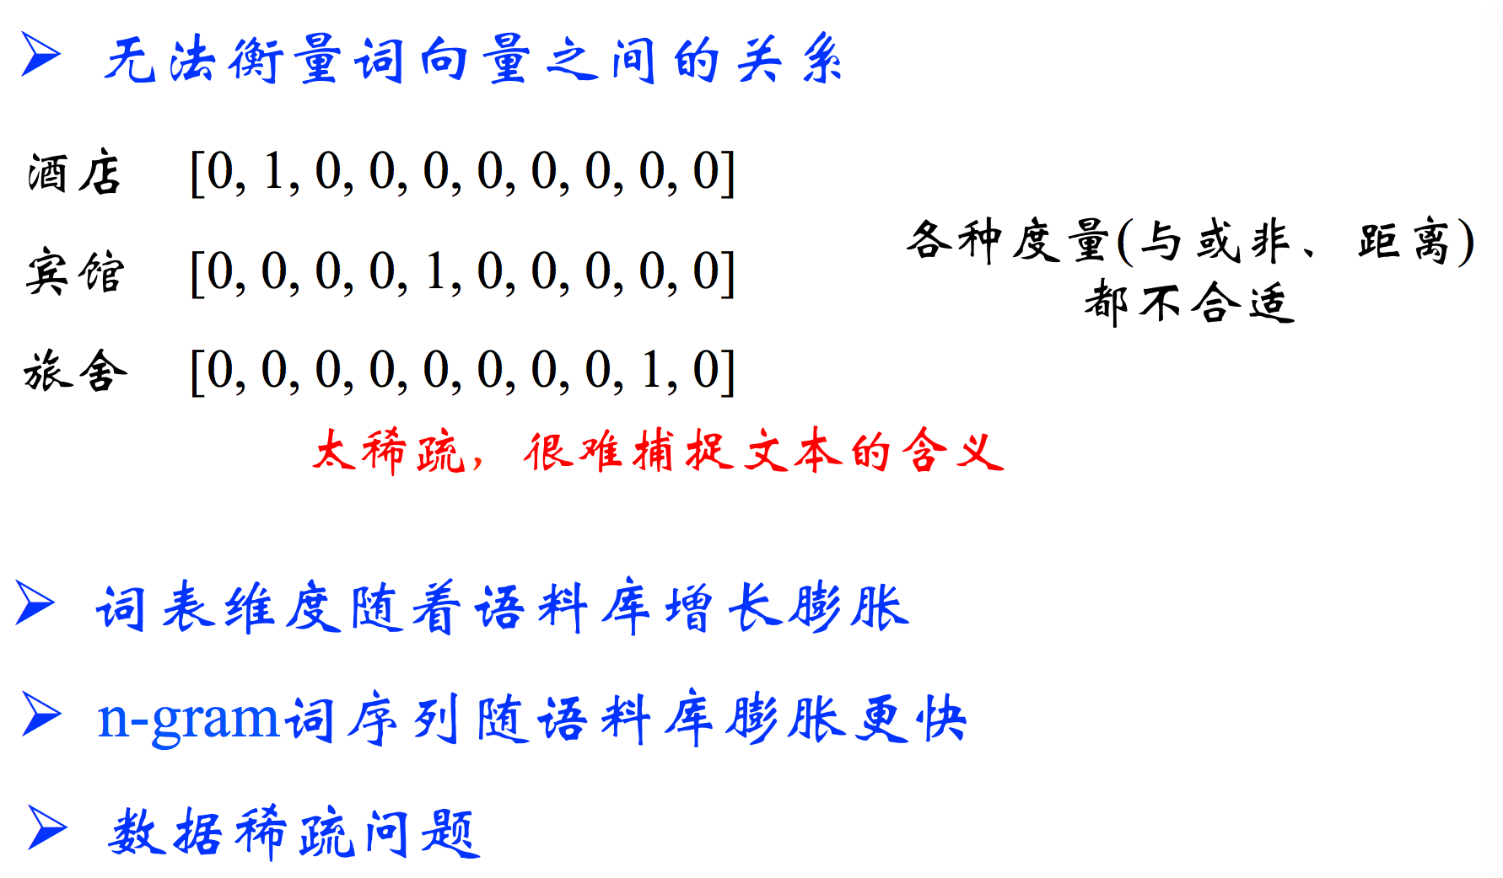
Bag of Words and N-gram Problem
There is no way to see the relationship between the vectors of words
Drama
Play
Performance
Too sparse, difficult to capture the meaning of document
The dimension of features increases with the corpus increasing
The dimension of features increases dramatically with the corpus increasing (N-gram)
Sparseness problem

Slide 7
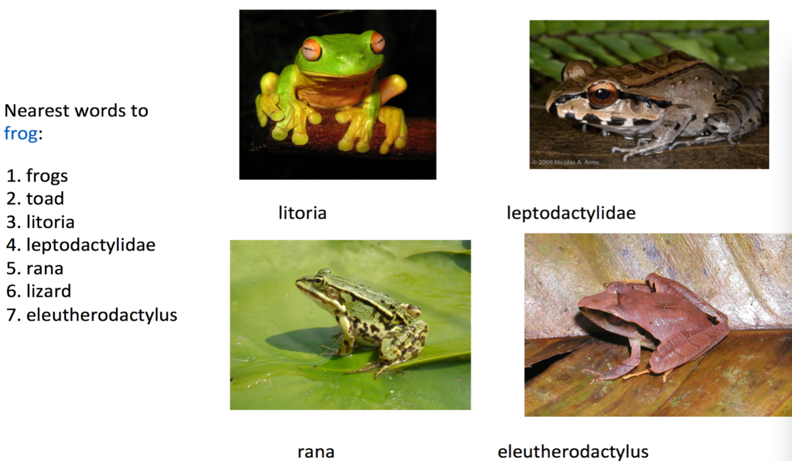
Bag of Words and N-gram Problem
There is no way to see the relationship between the vectors of words

Slide 8
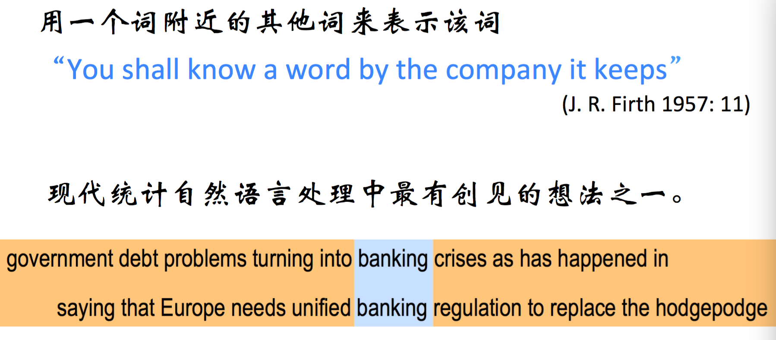
Intuition of Word2Vec
There is no way to see the relationship between the vectors of words

Slide 9
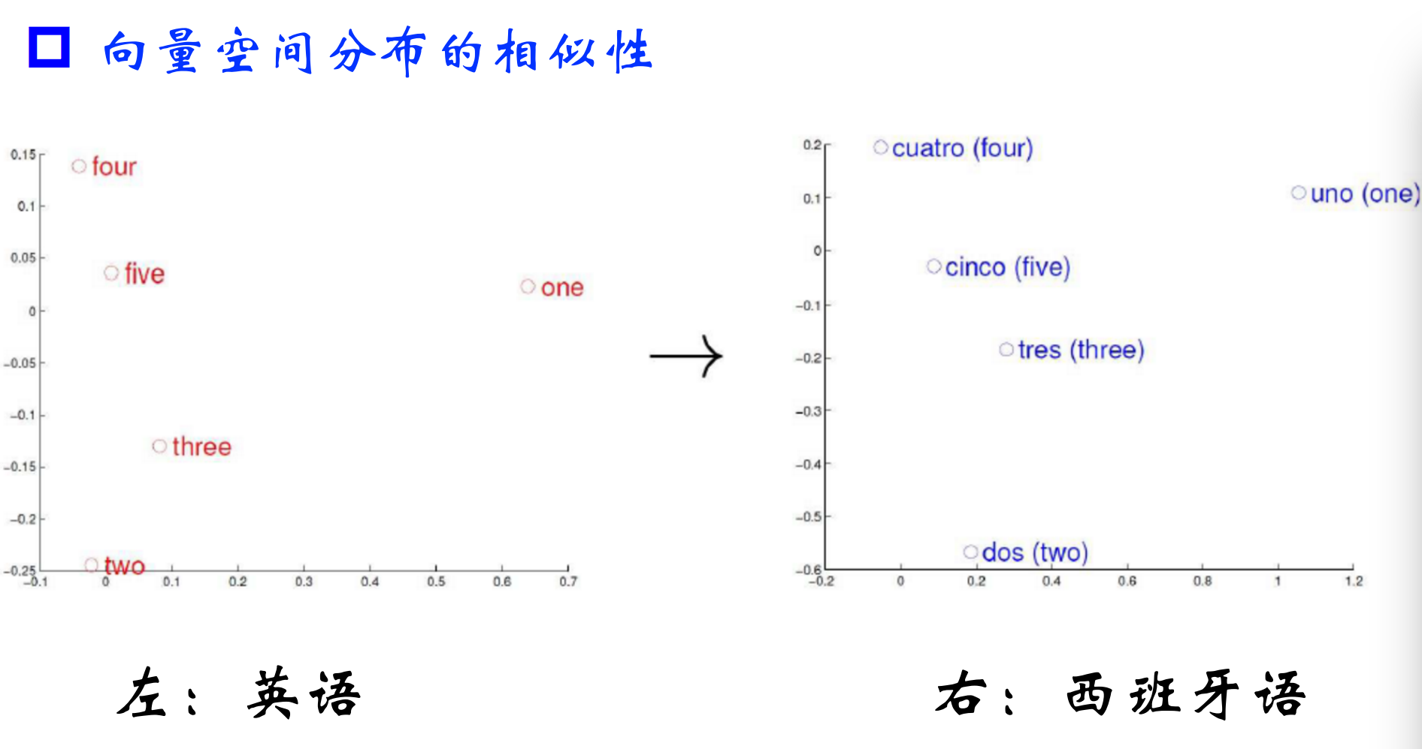
Word2Vec Overview
The similarity of vector distribution

Slide 10
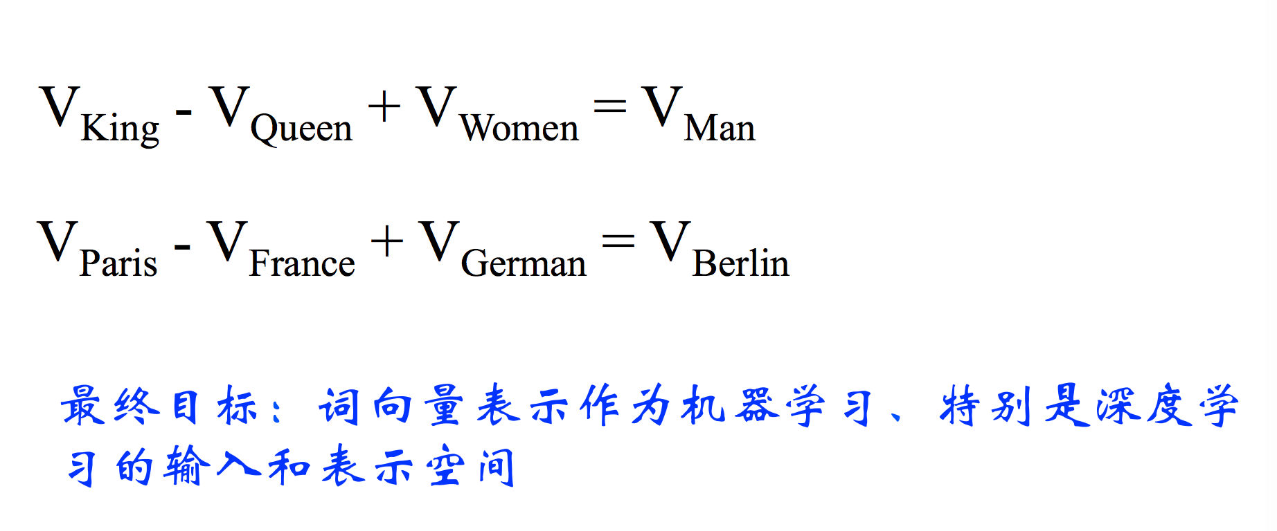
Word2Vec Overview
Final target: Word2Vec can be used as input for machine learning/ deep learning model

Slide 11
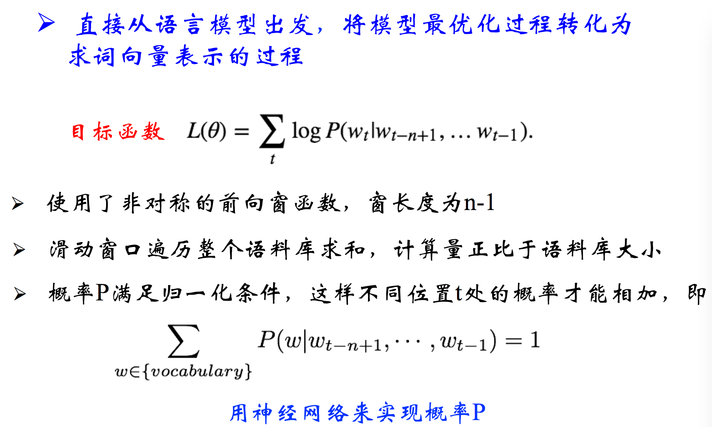
NNLM (Neural Network Language model)
The optimisation process of language model ->
the process of generate Word2Vec
Objective Function
Use asymmetric sliding window (size = n-1)
Sum the probabilities using sliding window based on each word in corpus
The probabilities need to fitful the normalization formulas:
Use neural network to get the probability

Slide 12
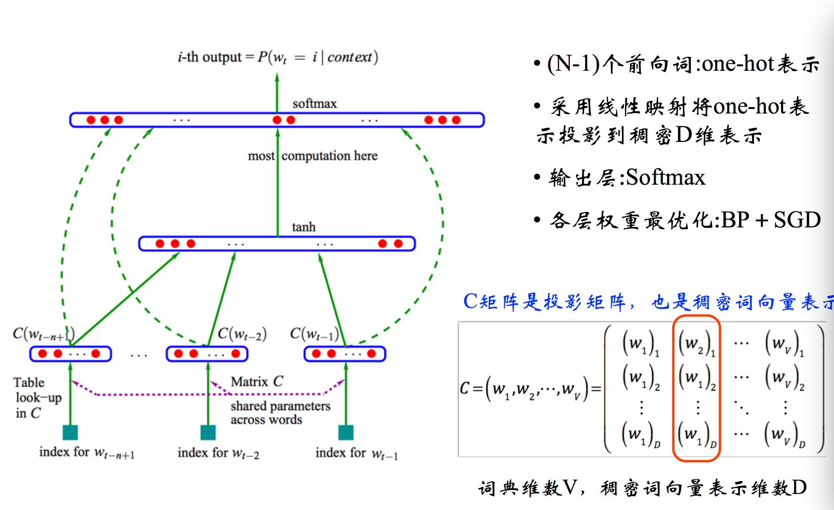
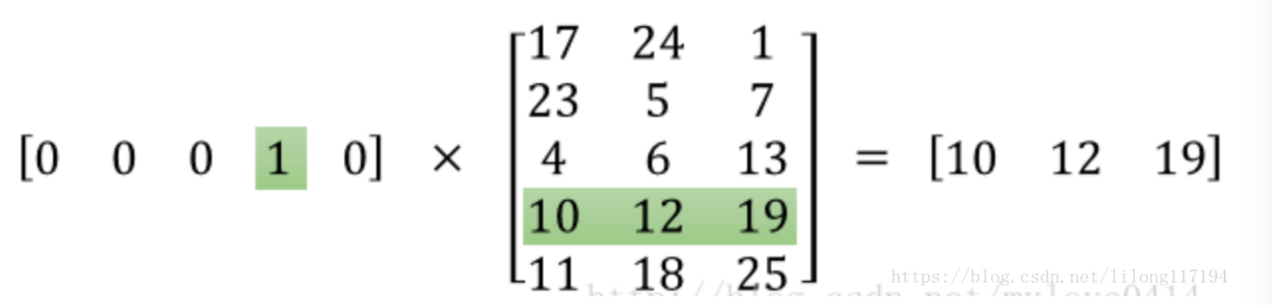
NNLM Structure
(n-1) preceding words: One-hot
Use linear projection to present word by
dense vector
Output layor: Softmax
Weight optimization: BP + SGD
1 * 3
5 * 3 (Vec Size)
C projection matrix: dense representation of words
1* 5 (Dictionary
Size)

Slide 13
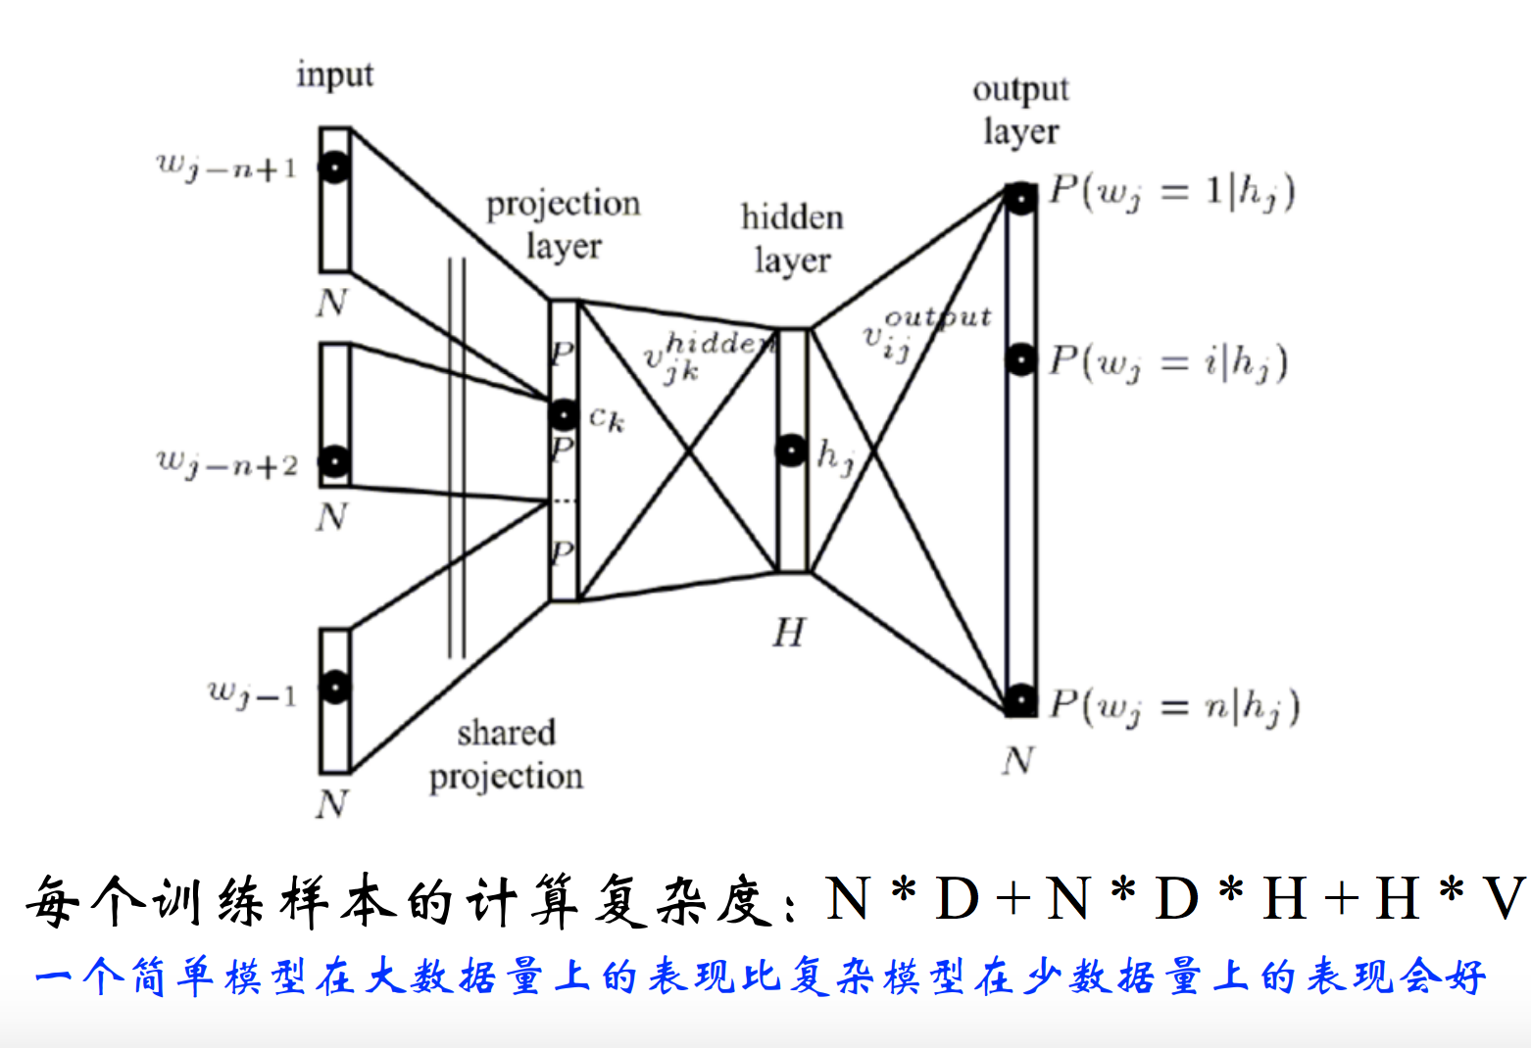
NNLM Structure
Calculation effort for each word:

Slide 14
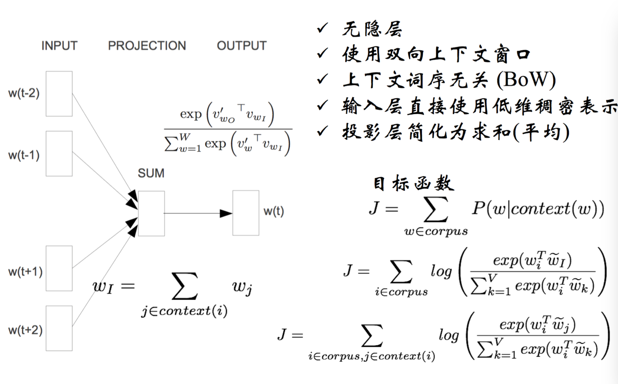
Word2vec: CBOW
No hidden layer
Uses bi-directional contextual window
No impacted by the orders of context words (BoW)
Input layor: One-hot
Projection layor: Sum of the vector
Objective Function
[1,500 ]
[1,40000 ]
[500,40000 ]: Time consuming

Slide 15
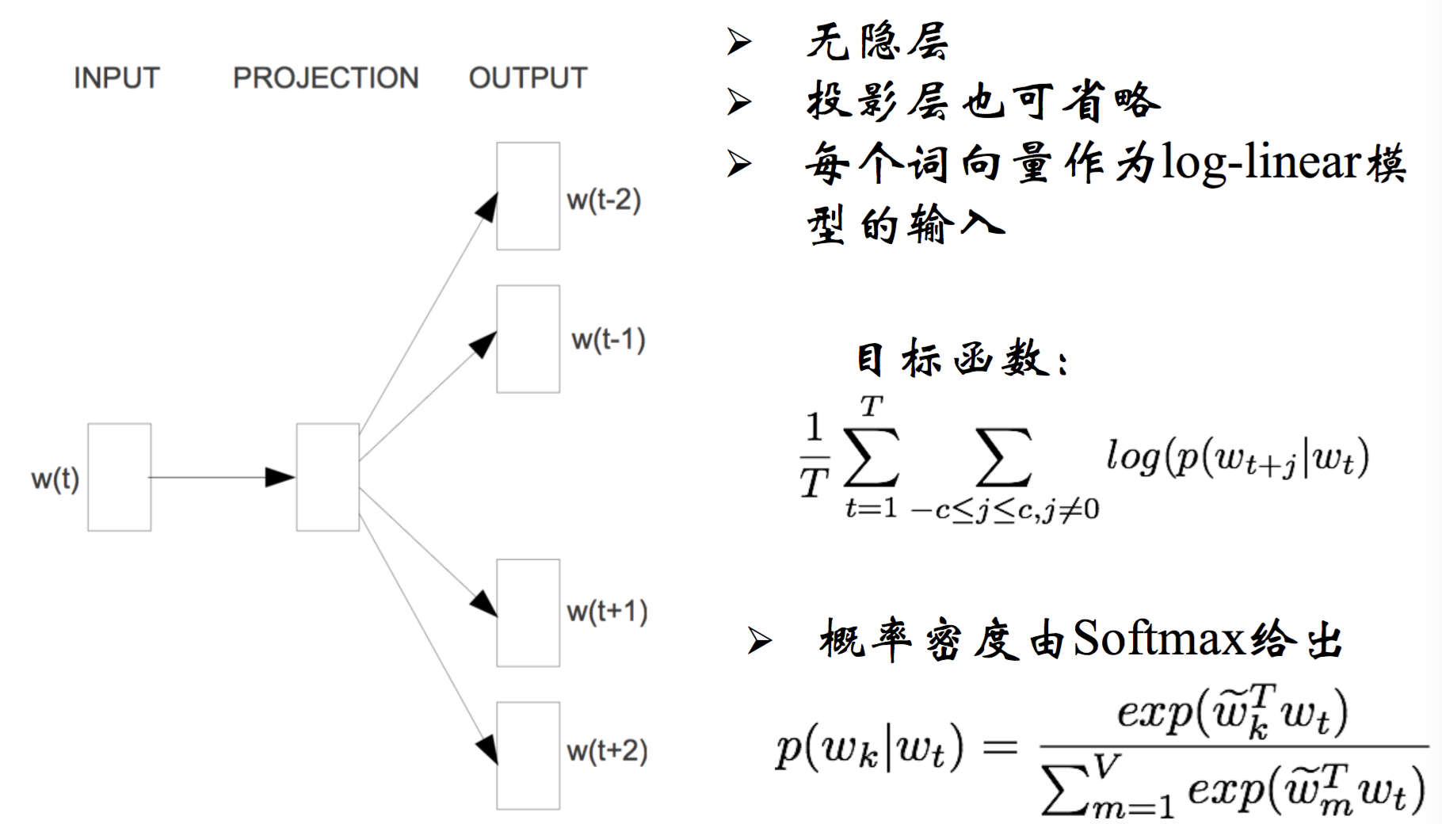
Word2vec: Skip-Gram
No hidden layer
Projection mayor can be ignore
The vector of each word can be input as log-linear model
Objective Function

Slide 16
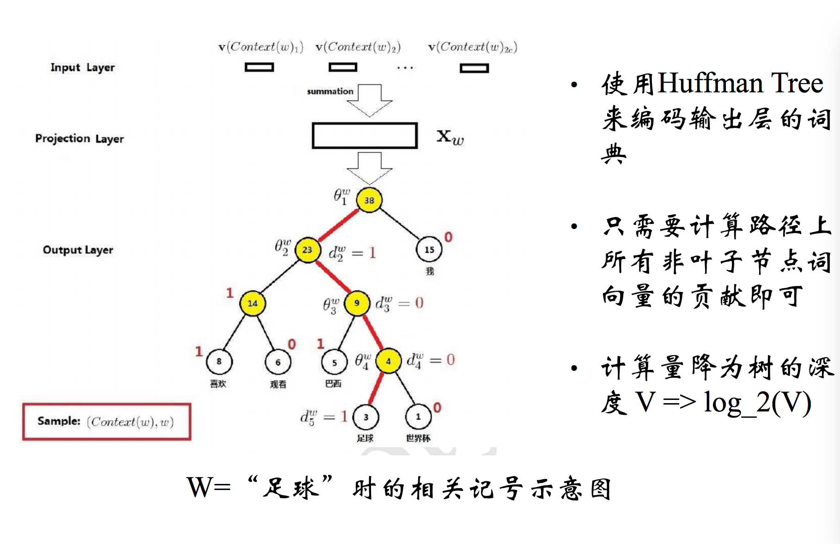
Optimisation Approach: Hierarchical Softmax
Use Huffman Tree to code
the dictionary for output words
Only calculate the path (Non-leaf node):
the word contribution (Binary Classification
on each node on path, the final prob = several LR
prob can be shared.)
The calculation cost :
The depth of tree log2(V)

Slide 17
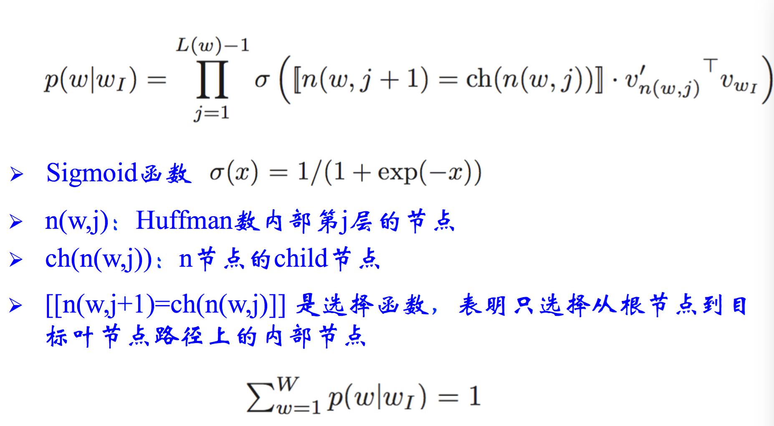
Optimisation Approach: Hierarchical Softmax
Choosing Function

Slide 18
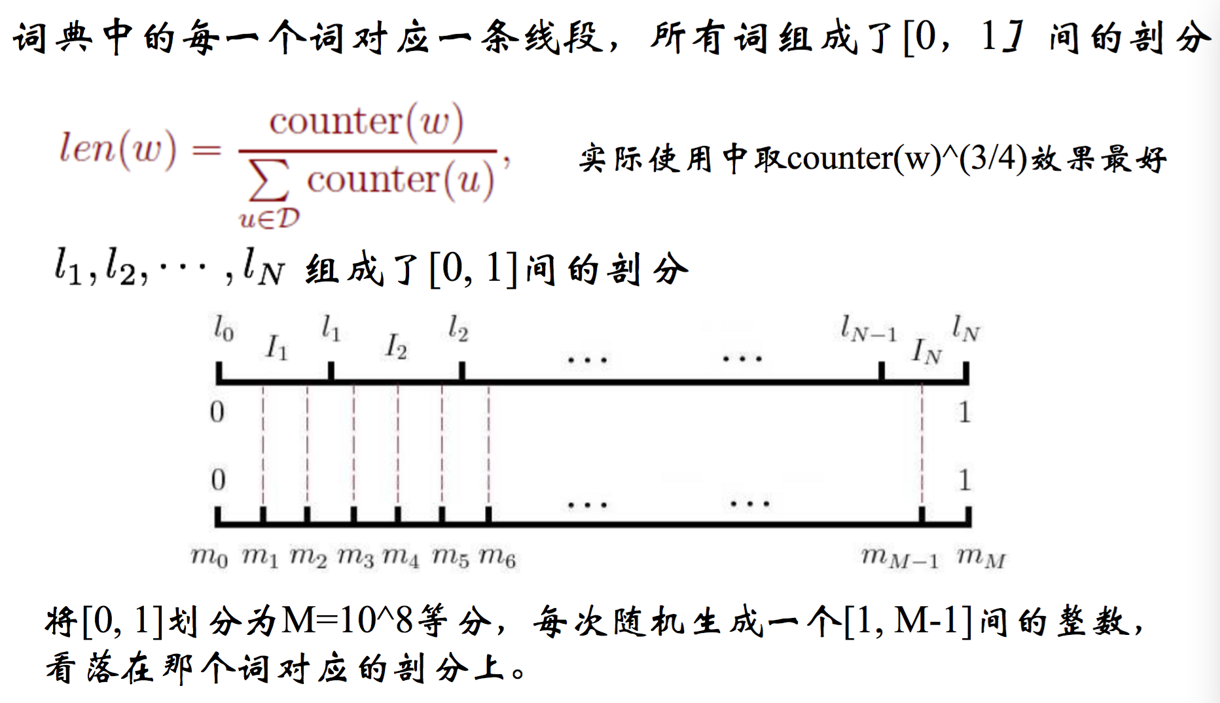
Optimisation Approach: Negative Sampling
Best Value:
[0,1] is divided into M= 10^8 part, a random number between [1,M-1]
is generated each time for word choosing

Slide 19
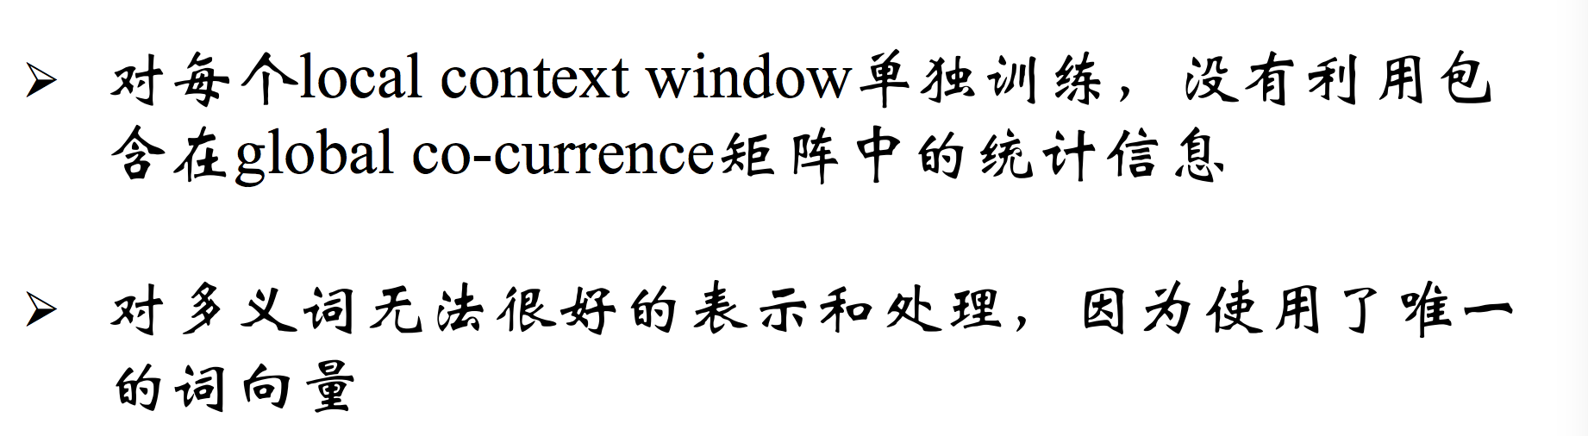
Word2Vec: Problem
Train based on local context window without using the information contained in global co-currence matrix. Solution: GLoVe
Unable to represent polysemous words as there is one vector of word.
Solution: sense2Vec

Slide 20
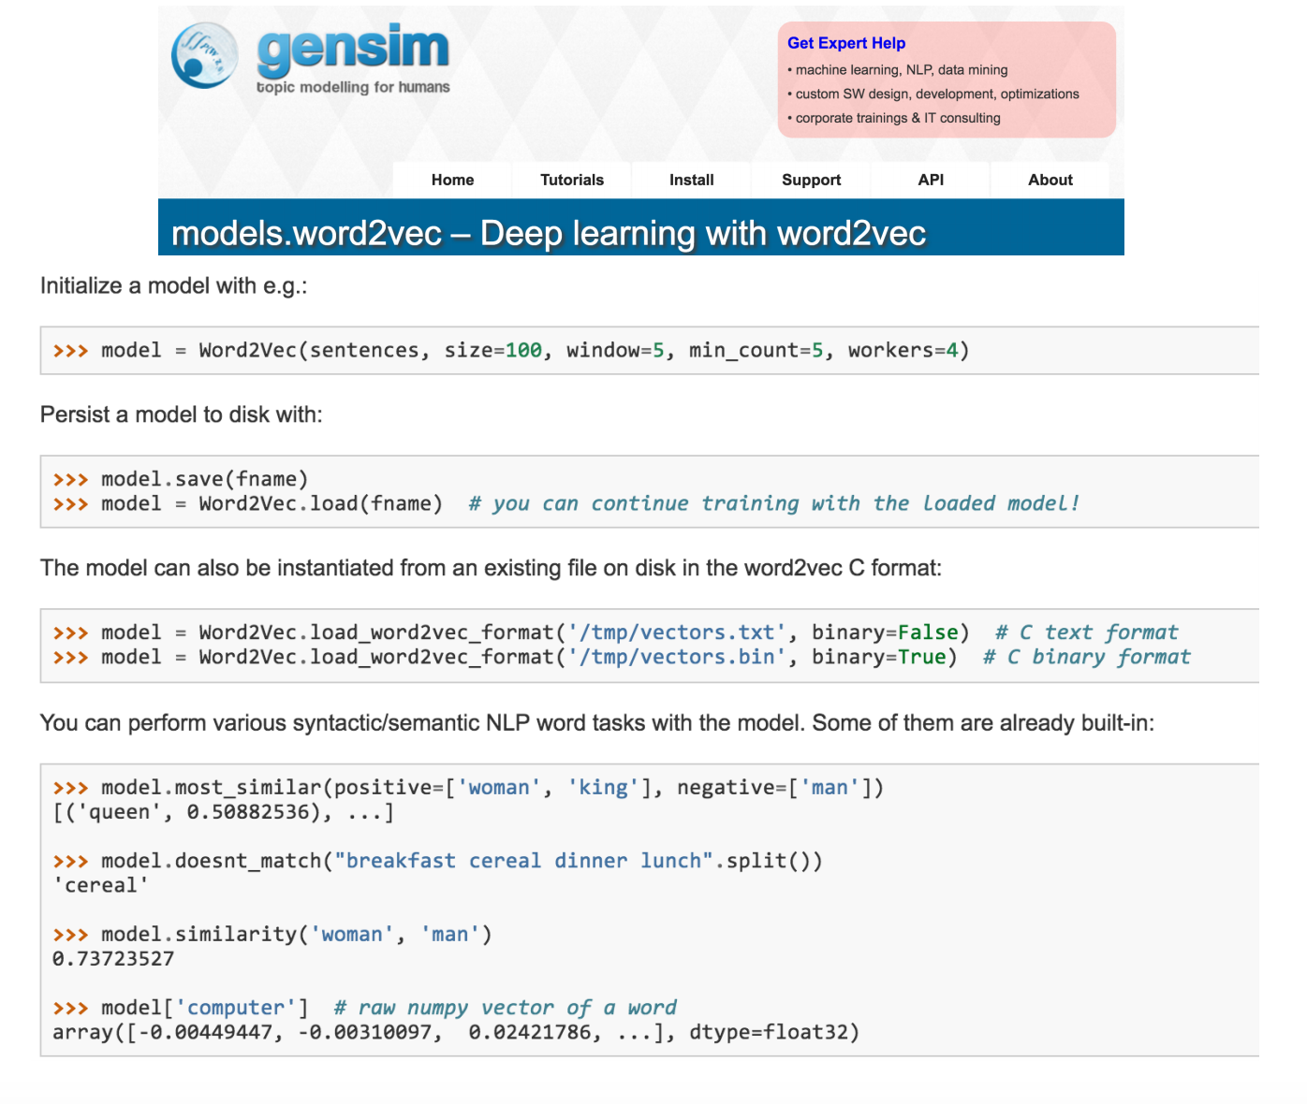
Word2Vec Implementation: gensim

